Slide 1
HERA Joint Research Programme
“Uses of the Past”
HERA JRP UP Facts
Application Process
Selection Process

Slide 2
HERA Joint Research Programme: General facts
Pooling national and European funding: research funding organisations in 24 countries plus the European Commission.
20 M € available for Humanities-led research in “Public Spaces: Culture and Integration in Europe”, including 4 m € European Union Cofunding.
Supporting excellent collaborative research across borders and beyond the state-of-the-art.
Supporting knowledge exchange with non-academic audiences.
1 Handling Agency for the selection process:
1 Handling Agency for managing the programme 2019-2022.

Slide 3
“Public Spaces” theme
Possible avenues of inquiry:
The concepts of an approaches to public space(s).
Historical patterns and forms of public space(s) and the relevance of such patterns.
The formation of public space(s) through institutional and non-institutional activities.
The roles played by culture, art creativity in shaping public spaces.
The impact of migration on culture and the creation and use of public spaces.
The role of public spaces in both enabling or challenging models of integration.

Slide 4
HERA Joint Research Programme
“Public Spaces: Culture and Integration Europe”
Proposal preparation and Application Process

Slide 5
Relevant documents
Call for Proposals.
General and National Eligibility Requirements.
FAQ.
Glossary.
Application template + budget template (Excel).
All documents are available online at www.heranet.info
Additional Checks
Project Leaders should register early for, the online submission system Isaac https://www.isaac.nwo.nl/en/home
Please ensure that you have looked at the latest eligibility guidelines and the FAQs on the HERA website, these are regularly updated while the call is open.
Note that some national funding organisations require that applicants should also submit additional documents to the relevant national funding organisation(s). Please see the HERA JRP PS General and National Eligibility Requirements for detailed instructions.

Slide 6
Partner Search Tool
A HERA Partner search tool is available through NCN (Polish Research Council):
https://ncn.gov.pl/partners/hera/.

Slide 7
Eligibility
Outline Proposals must follow the prescribed format and be submitted before the deadline of 24 October 2017, 14:00 CEST (Central European Summer Time).
At least 4 eligible researchers (Principal Investigators) from 4 different participating countries:
Austria, Belgium (Wallonia), Czech Republic, Croatia, Denmark, Estonia, Finland, France, Germany, Iceland, Ireland, Italy, Latvia, Lithuania, Luxembourg, Netherlands, Norway, Poland, Portugal, Slovenia, Spain, Sweden, Switzerland, United Kingdom
Maximum budget per project (across all partners): € 1 M
Project duration: Between 24 to 36 months.
Projects must start by May 2019 and finish by May 2022 at the latest.
All applicants and budget items must be eligible according to the National Eligibility Requirements (www.heranet.info).

Slide 8
IRC Eligibility Requirements
Maximum Funding: €242,500 i.e. budgets, including overhead costs, cannot exceed this amount.
Please note that applicants must submit their proposed budget to the IRC for review prior to the submission of their proposal.
Please aim to submit your budget a week in advance of the outline proposal submission deadline – Oct 24^{th.}
IRC eligible costs can be found here: http://heranet.info/system/files/hera_jrp_ps_general_and_national_eligibility_requirements_18092017.pdf

Slide 9
Principal Investigators (PI)
At least four PIs from four different eligible countries.
Each PI leads research activities at his/her institution.
One of the PIs (PI1 in your application) also functions as the Project Leader (PL) of the project.
Each PI must be eligible according the rules of his/her national funding organisation.
There can be more than one PI from the same country in one proposal (provided they are based at different institutions).
Only one PI from the same institution in one proposal; per institution there can be additional Project Members.
A PI may act in one proposal only.

Slide 10
Project Leader (PL)
PL is a senior researcher with solid experience of managing collaborative research projects.
Take equality and diversity dimension issues into consideration i.e. Where possible include early career stage researchers and female researchers.
PL submits the proposal on behalf of the whole project consortium.
PL is the contact point for the Handling Agency.
A PL may act in one proposal only.
If the funding is granted, the PL host institution will:
distribute the funds to other PI’s host institutions;
be responsible for proper financial management of the grant;
be responsible for all reporting duties.

Slide 11
Associated Partner (AP)
APs are stakeholders e.g. in the public sector, policy makers, and the creative and cultural sectors, who may provide significant added value and insights to the CRP from the user’s perspective.
They can be included in the proposal in a collaborative and advisory capacity to help explore the knowledge exchange potential of the proposed research.
For each Associate Partner (AP) a letter of commitment must be submitted which specifies the contribution of the partner to the CRP. The contribution of these partners to the CRP’s knowledge exchange potential should be well integrated in the workplan. No CVs of Associate Partners may be included in the proposal.

Slide 12
Co-operation Partners (CP)
A CRP may comprise researchers from non-HERA JRP PS countries in the form of Cooperation Partners (CPs) in order to strengthen the research capacity of the consortium.
Note that Cooperation Partners may only be added to an eligible HERA JRP PS consortium and that they cannot apply for HERA JRP PS funding themselves.
The contribution of CPs (researchers from non-HERA JRP PS countries) to the project must be specified in the description and planning of the CRP.
For each CP a letter of commitment must be submitted, specifying the contribution to the project. Note that CPs cannot function as PI; CVs may not be included.

Slide 13
Description of the project (max. 2000 words)
What research question(s) does the CRP seek to answer?
In what way is the project original and/or innovative?
What are the objectives of the CRP?
By what methods will the research question(s) be tackled?
How are the skills of the partners complementary?
What is the added value in tackling your research question(s) from a European trans-national perspective?
How will partners work together? What management and coordination structures are proposed?
What is the significance of the research question(s)? How will these contribute to the “Public Spaces” theme?
What is the potential impact of the proposed research to both academic disciplines, and relevant stakeholders and user communities?
How will the CRP engage in knowledge exchange or active dissemination engaging user communities and audiences outside academia?

Slide 14
Research Integrity
The HERA partners expect researchers to adhere to the rules of good research practice as outlined in
The European Code of Conduct for Research Integrity
Fairness in providing references,
Giving credit to collaborators,
Honesty in communication, and impartiality and independence.
To download the publication:
http://www.allea.org/wp-content/uploads/2017/03/ALLEA-European-Code-of-Conduct-for-Research-Integrity-2017-1.pdf

Slide 15
Open Access
All HERA JRP PS projects will be required to follow the guidelines on Open Access for publications and data adopted for the Horizon 2020 programme: http://ec.europa.eu/research/participants/data/ref/h2020/grants_manual/hi/oa_pilot/h2020-hi-oa-pilot-guide_en.pdf

Slide 16
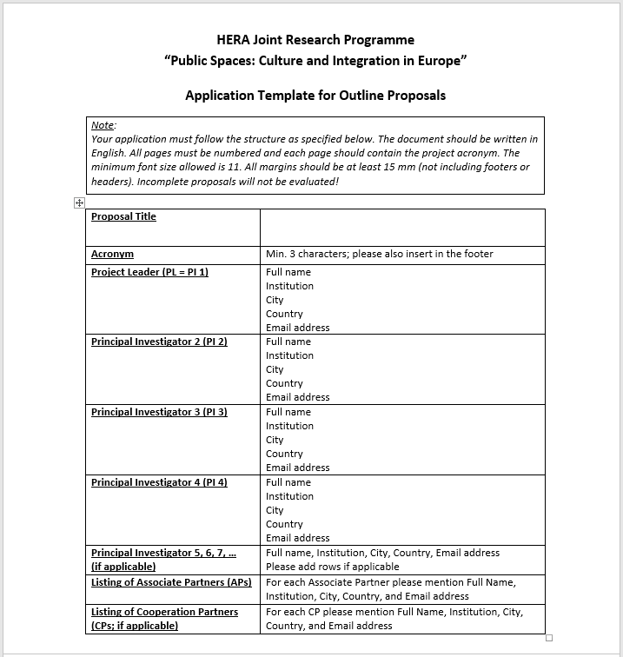
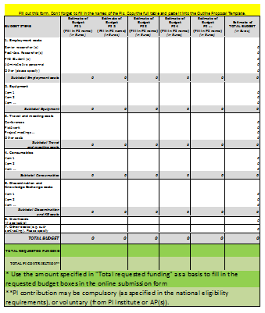
Outline Proposal templates

Slide 17
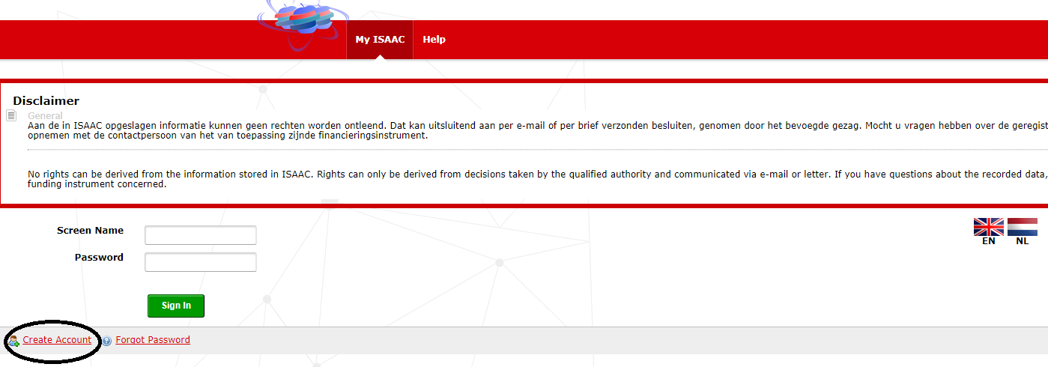
Outline Proposal submission
Instructions available at http://heranet.info/system/files/HERAJRPPS/hera_jrp_ps_guidelines_to_submit_an_outline_proposal_01092017.pdf
Only the Project Leader can submit an application on behalf of the CRP.

Slide 18
HERA Joint Research Programme
“Public Spaces: Culture and Integration in Europe”
Selection Process

Slide 19
Selection Process: two stages
1st stage: Outline Proposals
Outline Proposals are evaluated by the international Review Panel;
Shortlisted applicants are invited to submit Full Proposals.
2nd stage: Full Proposals
Each Full Proposal is evaluated by at least three external expert referees;
Rebuttal by applicants: applicants are invited to submit comments on anonymous referee evaluations.
The international Review Panel evaluates and ranks Full Proposals.
The HERA JRP UP Board makes final funding decisions.

Slide 20
Timeline
24 Aug 2017 Launch of the Call for Outline Proposals.
24 Oct 2017 Deadline for the submission of Outline Proposals.
Jan 2018 Review Panel: selection of Outline Proposals.
Feb 2018 Invitation for the submission of Full Proposals.
9 May 2018 Deadline for the submission of Full Proposals.
May-Aug 2018 Peer review of Full Proposals
Sept 2018 Rebuttal by applicants (one week).
Oct 2018 Review Panel: ranking of Full Proposals.
Dec 2018 HERA JRP Board meeting: funding decisions.
Dec-May 2019 Contract negotiations.
May 2019 Start of Collaborative Research Projects.
May 2022 End of Collaborative Research Projects.

Slide 21
Review Panel
The Review Panel members are leading humanities scholars appointed by the HERA JRP UP Board.
~30 members in the Outline Proposals stage.
~12 members in the Full Proposals stage.
Conflict of Interest guidelines are applied throughout the selection process.
The names of the Review Panel members will be published after the Call for Proposals is launched.
The Review Panel members must not be contacted by applicants! All questions about the selection should be directed to the Handling Agency (hera@nwo.nl).

Slide 22
Selection Criteria for Outline Proposals
In the outline proposal phase, the review panel will select proposals by applying the following weighted criteria:
Relevance to the theme “Public Spaces: Culture and Integration in Europe” (30%).
Potential for research excellence (40%).
Potential impact of the proposed research beyond academia (15%)
Quality of the implementation and management (15%).

Slide 23
What you should do to succeed:
Read all the guidance documentation published on the HERA website www.heranet.info.
Verify the eligibility of the applicants and budget items according to the National Eligibility Requirements.
Contact the HERA office or your National Contact Point, if you have questions.
Make sure you understand the evaluation criteria.
Describe your project idea (incl. objectives, methodology, collaboration and potential impact) within the given space of 2000 words!
Arrange face-to-face meetings with your project partners when writing the proposal to ensure coherence of ideas.
Use clear and straightforward language.
Upload your proposal well ahead of the submission deadline! Register in time!!

Slide 24
For more information:
visit www.heranet.info
or contact us at: hera@nwo.nl
Sander Steeman, Programme officer,
Netherlands Organisation for Scientific Research (NWO)

Slide 25
IRELAND
Fiona Davis & Dr Aileen Marron
Irish Research Council (IRC)
E-mail: HERA@research.ie
Twitter: @HERA_research

