Slide 1

New Foundations 2024 Strand 4:
A Better World Awards

Slide 2

Collaboration and Networking

Slide 3
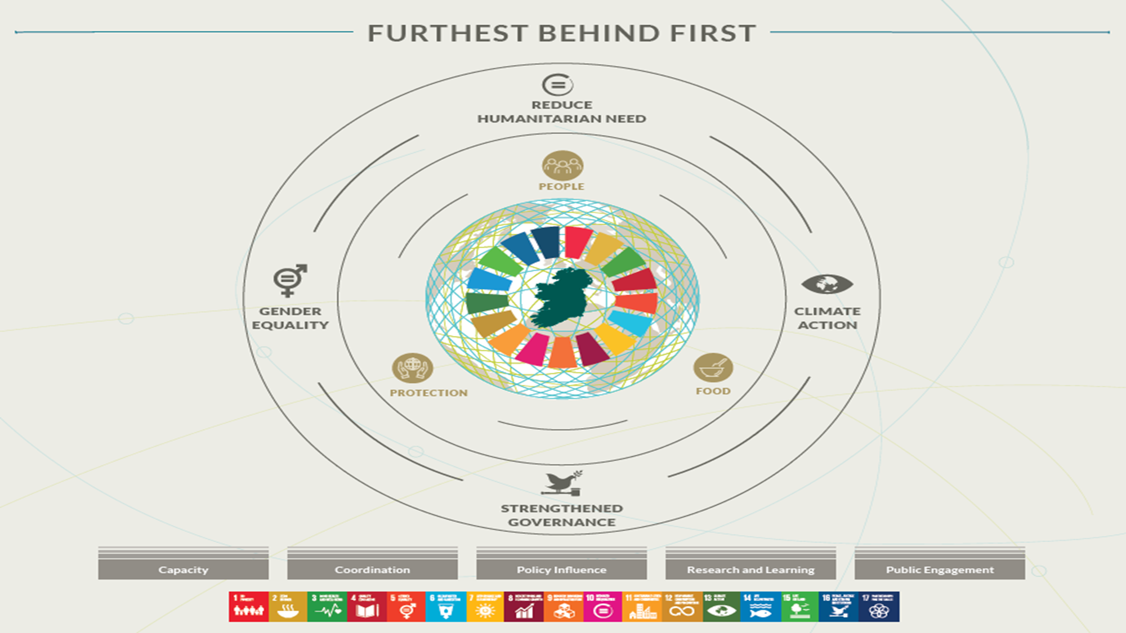

Slide 4
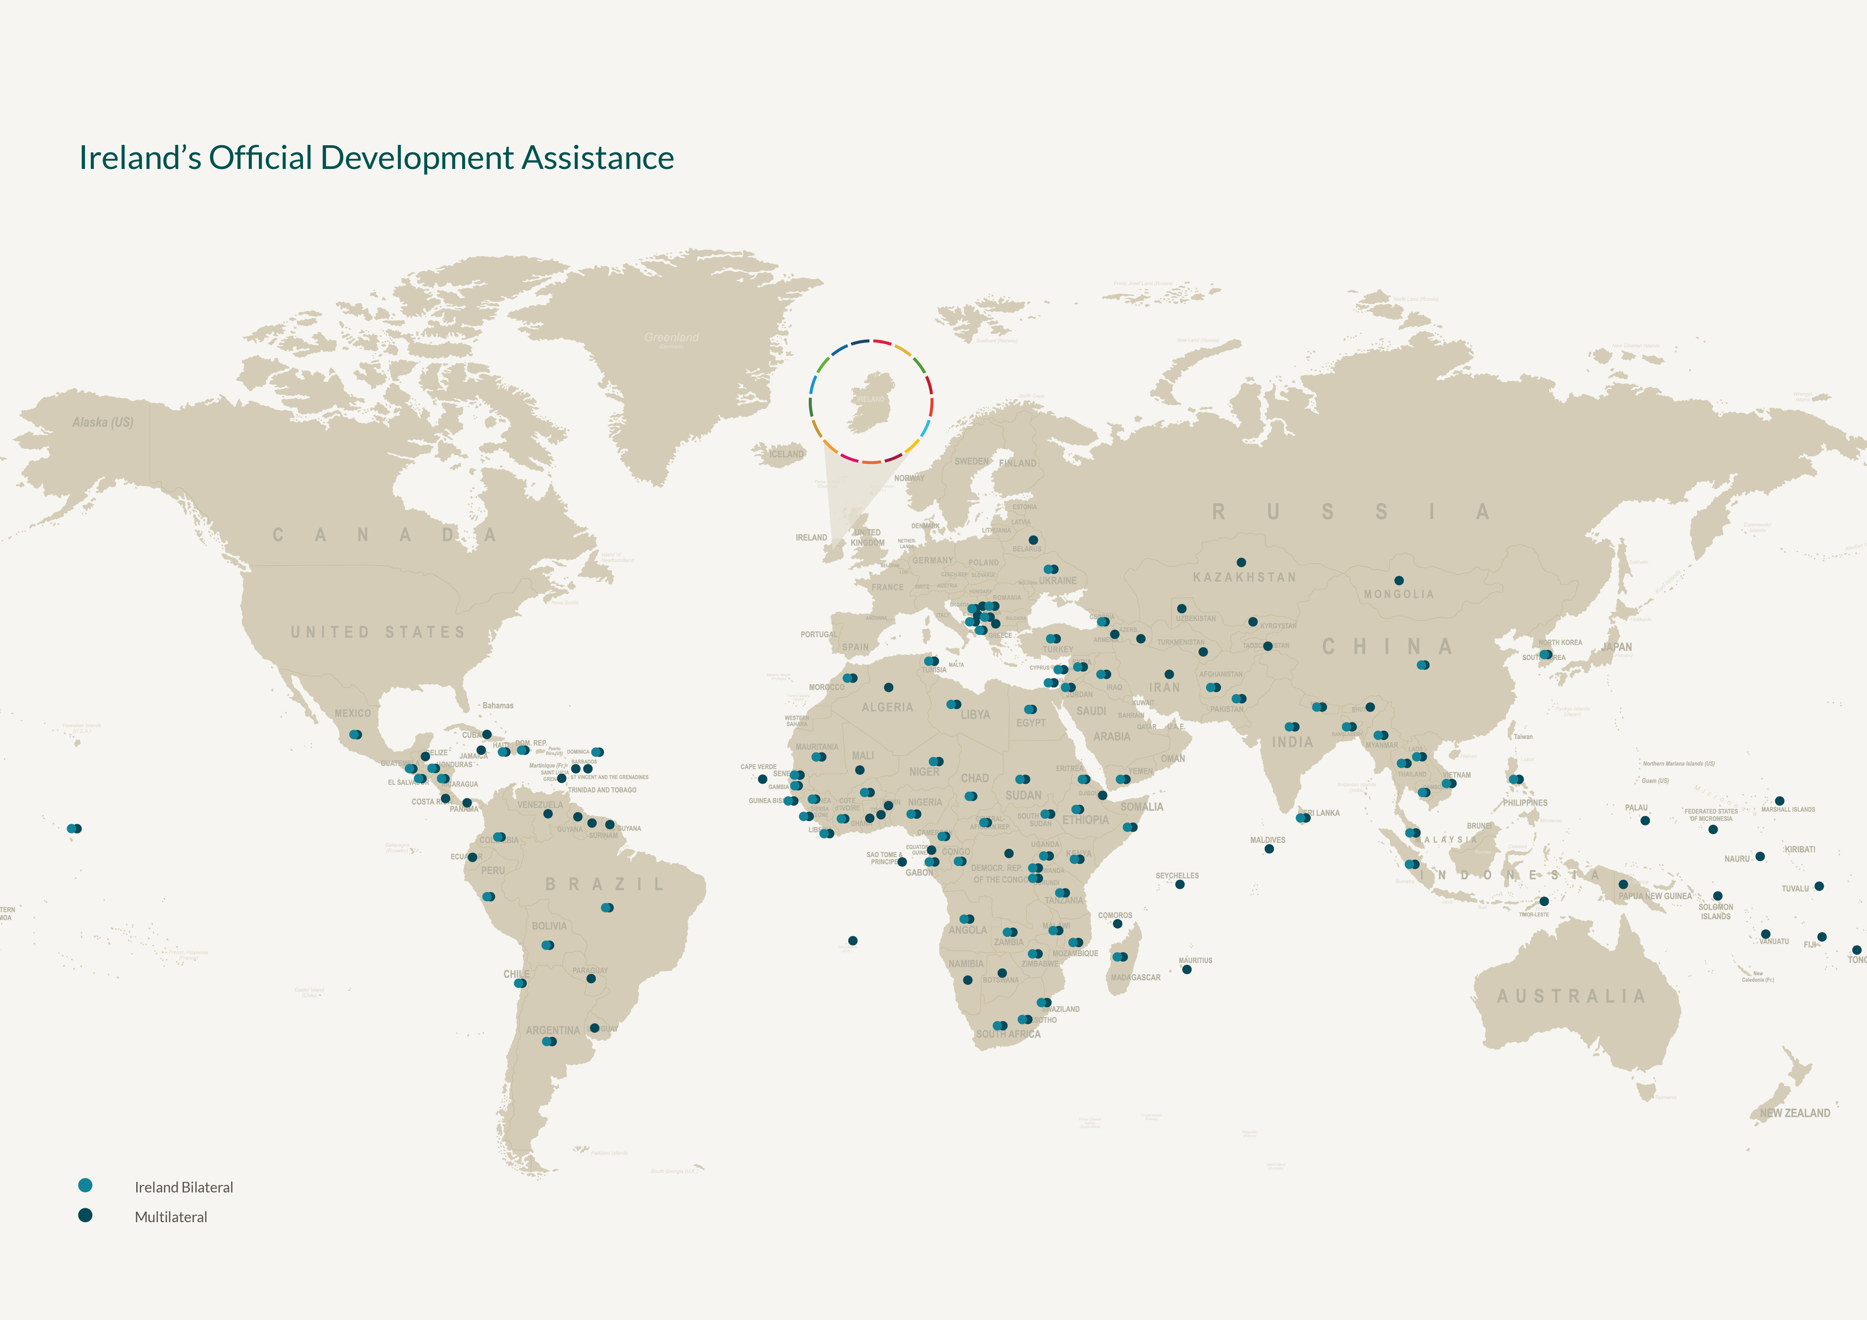
Where we work
Funding is based on ODA eligibility
Applications welcome from:
ODA eligible countries in Africa
ODA eligible Small Island Developing States
Vietnam
Laos
Cambodia
Palestine

Slide 5
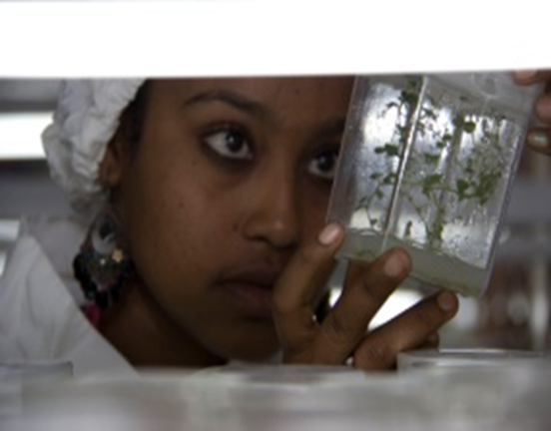
Research in A Better World
Research is central to Ireland’s development policy.
Research agenda aligned with policy priorities.
Collaboration with public and private organisations in Ireland
Supporting challenge based research
Building networks between Irish and international researchers
Enhancing contribution of research to achieving the SDGs

Slide 6
Collaboration and Networking
Main areas of focus:
Promote research consortia, led by Irish institutions with international partners, including in developing countries, to develop strong research portfolios and profiles.
strengthen transnational and collaborative research capacity.
strengthen the capacity of research institutions and networks in developing countries.
Encourage an exchange of expertise, knowledge and capacity between north and south.

