Slide 1
Professor Deiric O’Broin and Adjunct Professor Philip McDonagh
Dublin City University
CENTRE FOR RELIGION, HUMAN VALUES, AND INTERNATIONAL RELATIONS
Assisting the Irish churches and faith communities to develop values-based common positions on current European issues and to engage with European counterparts.

Slide 2
Consultations at the Helix, February 2022
Over the two days, working groups addressed the following themes:
1. Global challenges/World Social Summit 2025
2. Founding values of post-war Europe
3. Wellbeing indicators and an overall vision of the economy
4. Migration policies
5. Housing policy and the future of Europe
6. International security/The Good Friday Agreement approach to EU peacebuilding
7. The dialogue between faith communities and public authorities
8. The media, technology, and the future of Europe

Slide 3
Keynote presentations
Francis Jacobs (“Founding values of post-war Europe”)
Anne Barrington (“Housing and the future of Europe”)
Jane Morrice (“the Good Friday Agreement approach to EU peacebuilding”)
Bishop Noel Treanor (“Conference on the Future of Europe”)
Catherine Day (“EU and Irish migration policies”).

Slide 4
RELIGIOUS LEADERS
welcoming speeches
Bishop Brendan Leahy (Irish Inter-Church Meeting)
Archbishop Michael Jackson, Dublin City Interfaith Forum Chair
Derick Wilson (Corrymeela)
panel
chair: Archbishop Michael Jackson
Gillian Kingston, Vice-President, World Methodist Council
Karen Jardine, Presbyterian Church in Ireland
Ahmed Hasain, Islamic Cultural Centre
Dr. Hemant Kumar, Vedic Hindu Cultural Centre of Ireland
Bishop Brendan Leahy.

Slide 5
Recommendations
public authorities should recognize that the granular provisions of the law depend on, and nurture in turn, a worldview and way of life. Therefore, the “soul of Europe” is be discovered in action, in the dialogical relationship between high-level values and practical politics
on the island of Ireland, we should bring to the discussion on values our experience of the Good Friday Agreement and the unfinished work of peace. We need to promote where possible a rounded understanding of security and peace based on relationships
“well-being frameworks,” which are under consideration in both jurisdictions, can enable us to pursue key underlying values, such as equity, across different “domains”. The COVID vaccination program is a useful precedent for investment in the infrastructure of society
on housing policy, the Conference on the Future of Europe presents us with an opportunity to learn from other Member States and also to look at wider European and global frameworks which shape the facts on the ground. We identified four key channels through which the EU can help address current challenges
on migration, we should support political leaders in national politics and the European institutions as they seek to develop a more consistent and ambitious strategy at a European Union and global level
technological development should be politically accountable and should be steered in a “human-centred” direction. Measures are needed to address threats to democratic discourse arising from the new means of communication.

Slide 6
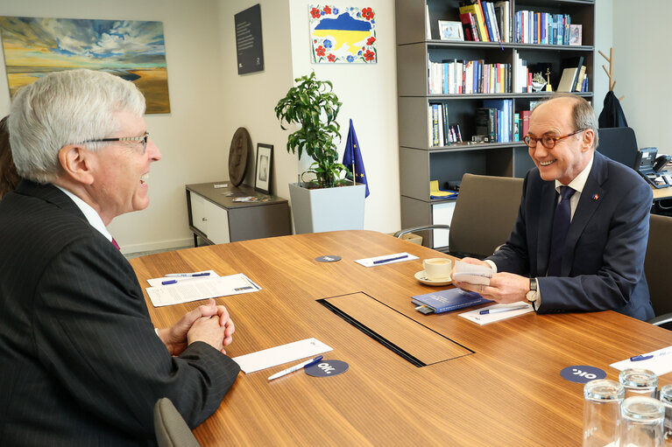
Dr. Othmar Karas
First Vice-President of the European Parliament responsible for the Article 17 dialogue

